Slide 1
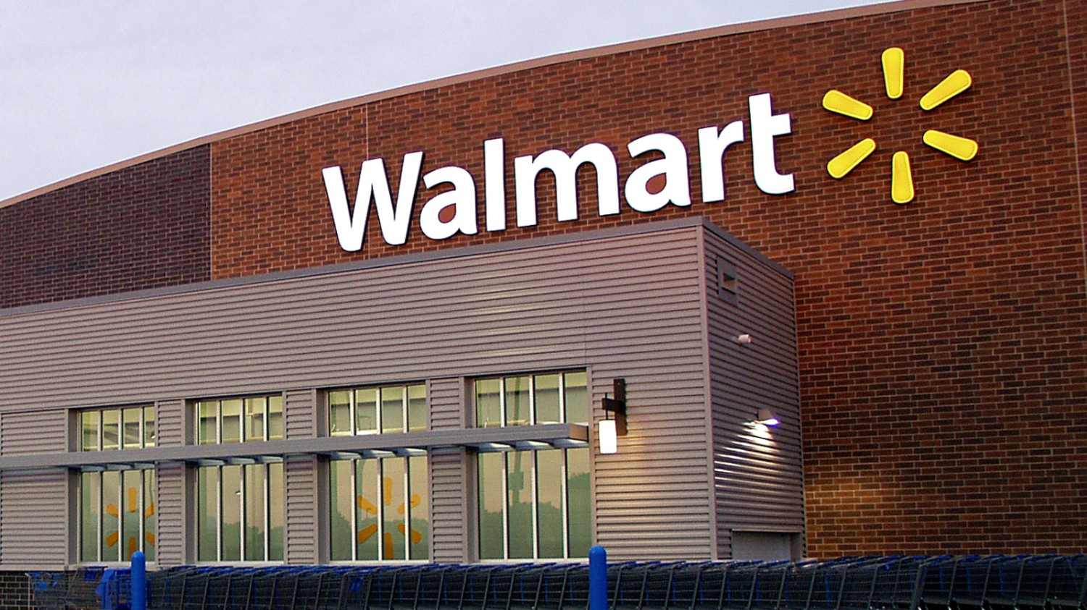
Annual Company Report 2023 - 2024
FIN ACC 510-B
Presented by :- Niket Shah

Slide 2
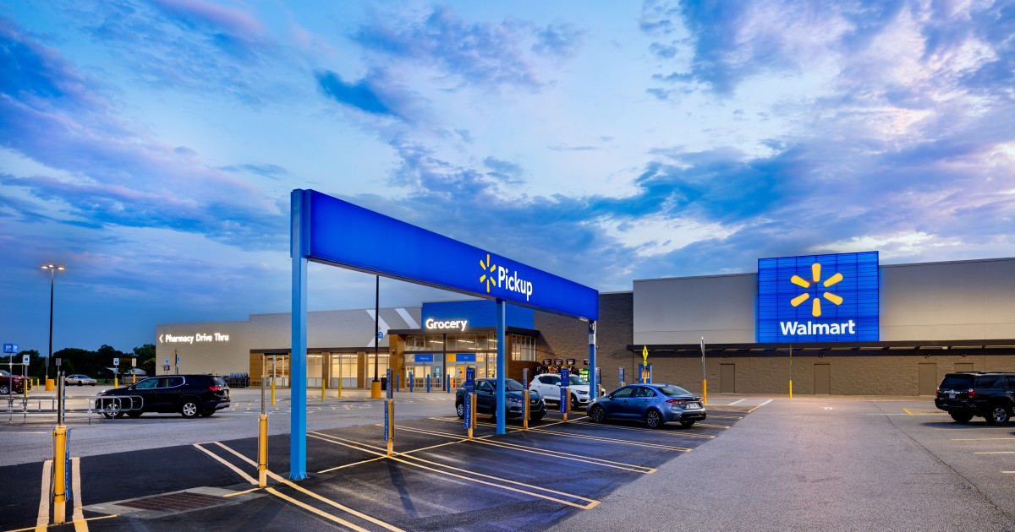
ABOUT THE COMPANY
Walmart was founded in the year 1962, by Sam Walton in Rogers, Arkansas, USA.
Walmart has its headquarters in Bentonville, Arkansas, USA.
As of 2024, the CEO of Walmart is Doug McMillon.
It employs more than 2.3 million people globally, ranking among the biggest private employers.
Walmart consistently ranks as the world's largest retailer by revenue, with annual sales exceeding $600 billion.
The business aim of Walmart Inc. is to "save money, live better."

Slide 3

Business Segments
Walmart U.S: This is Walmart’s primary retail segment, including its hypermarkets and discount stores across the United States. It is the largest business segment, accounting for 75% of Walmart's operating income.
Walmart International: It is Walmart's global operations outside of the United States and Canada. Walmart has over 10,500 stores and clubs in 24 countries.
Sam’s Club: A membership-based warehouse club offering a wide variety of products, including bulk items and exclusive brands at lower prices to individuals and businesses.

Slide 4

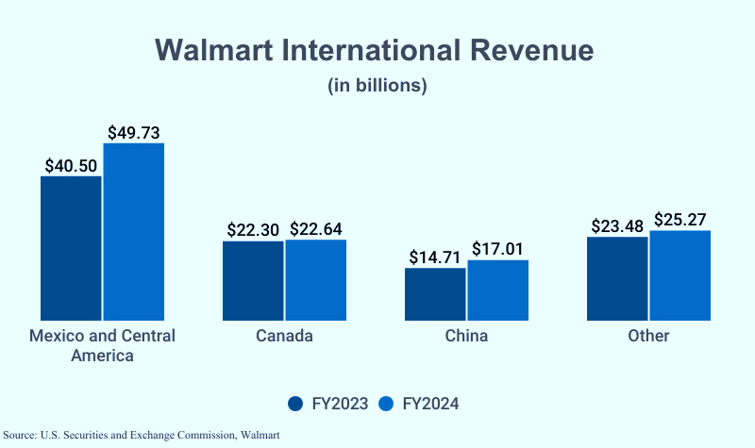
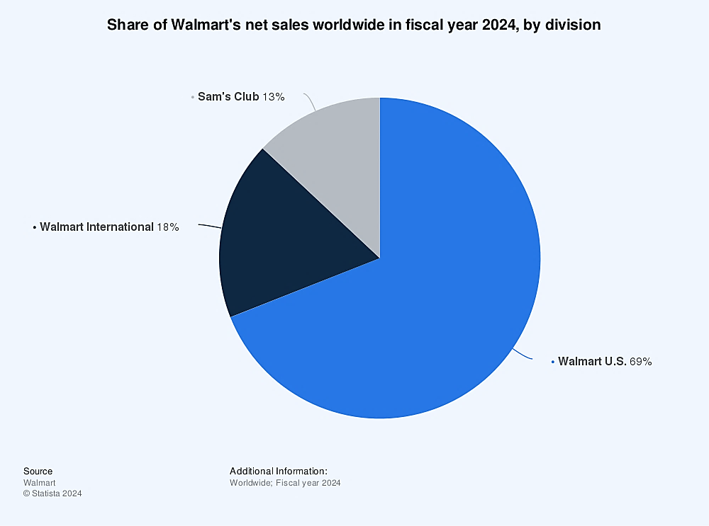
Key Business Metrics
Net sales for the Walmart U.S. segment totalled $441.817 billion in FY2024, equivalent to 68.2% of total revenue.
Walmart International segment net sales totalled $114.641 billion in FY2024.
Sam’s Club net sales, including fuel, totalled $86.179 billion and excluding fuel, Sam’s Club stores netted $75.057 billion.
Overall, Walmart's global net sales amounted to $642.6 billion, marking a 6% increase from the previous fiscal year.

Slide 5

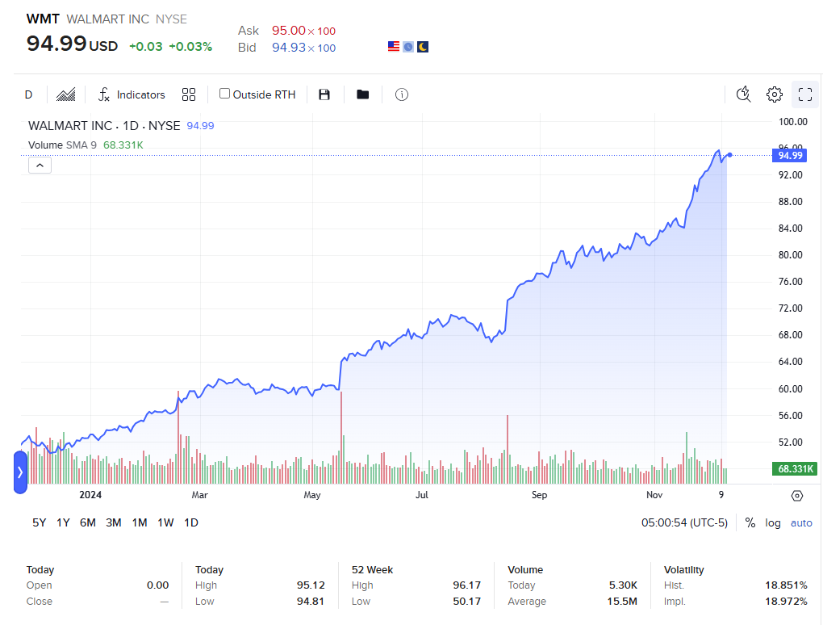
STOCK PRICE
1 Year Stock Price History
Walmart's initial public offering (IPO) was listed on October 1, 1970, on the New York Stock Exchange (NYSE) under the ticker symbol WMT. The stock was initially priced at $16.50 per share.
The stock reached an all-time high closing price of $95.70 on December 6, 2024.
The Walmart 52-week high stock price is 96.18, which is 1.28% above the current share price.
The Walmart 52-week low stock price is $50.21, which is approximately 47.13% below the current share price
The Average Walmart stock price for the last 52 weeks is 68.02.
Market cap | 759.56B USD
P/E ratio | 39.24
Dividend yield | 0.99%
Primary exchange | NYSE
TICKER SYMBOL | WMT

Slide 6
Current Activities
Fintech Innovation – Walmart is exploring to find financial technology solutions to offer more financial services, such as digital wallets, financial planning tools and enhanced payment options through partnership and internal development.
Expansion of Walmart MoneyCard – Growth of the Walmart MoneyCard offering new features and benefits like checking a price of product by scanning the QR code of the product to attract more users. They also have patented their Walmart payment app through which users can pay directly from their wallet.
Instore technology – Introduction of new technologies in stores, such as self-checkout stations, smart shelves and interactive digital display.

Slide 7

Future Prospects
Store Expansion and Modernization: Over the next five years, Walmart plans to build or convert more than 150 stores in the United States. In the next 12 months, the company aims to remodel 650 stores, incorporating its "Store of the Future" concept, which features improved layouts, expanded product selections, and innovative technology to enhance the shopping experience.
Supply Chain Automation: Walmart is enhancing its supply chain with automation, robotics, and intelligent software to improve inventory accuracy and efficiency. By fiscal 2026, 65% of stores are expected to be serviced by automation.
Technological Innovations: Walmart is using AI, Generative AI, and AR to create personalized shopping experiences and improve customer support with AI-powered assistants. It is also expanding drone delivery services offering delivery times of 10 to 30 minutes.
Walmart is enhancing the shopping experience with in-store advertising via digital screens and audio marketing. It has also expanded "Buy Now, Pay Later" options to self-checkout lanes for more flexible payments.
Walmart anticipates increasing its efforts in proprietary data optimization and large language models (LLMs) in 2025. Additionally, they anticipate optimizing small language models (SLMs) for certain applications.

Slide 8
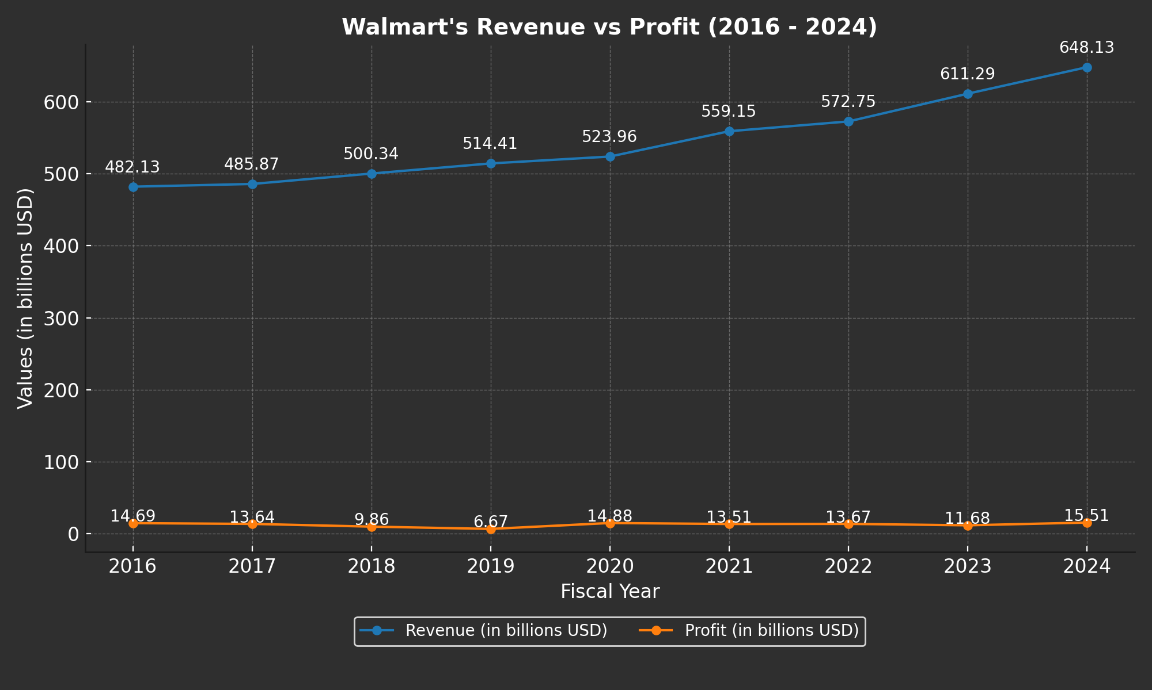

Slide 9
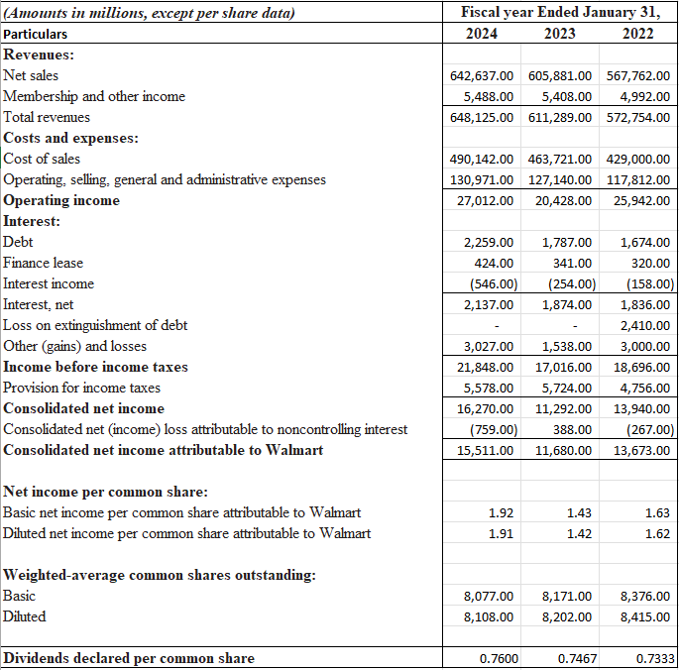
Income Statement
Walmart annual revenue for 2024 was $648,125 billion, a 6.00% increase from 2023. Walmart annual revenue for 2023 was $611,289 billion, a 6.7% increase from 2022. Growth is driven by increased net sales and membership income.
The company observed an increase in net income by 32.8% in the year 2024 as compared to 2023. However, the company’s profits fell by 14.58% in the year 2023 as compared to 2022. This reflects higher revenues, improved operations, and gains despite rising costs.
The operating income grew by approximately 32.23% from 2023 to 2024. Although, it decreased by 21.26% from 2022 to 2023.
Rising costs, particularly in Cost of Sales and SG&A, highlight investments and inflationary pressures. Walmart is continuing to invest in development and digital transformation as evidenced by the $3.8 billion increase in 2024.
Walmart's EPS and dividends growth make it an attractive option for investors.

Slide 10
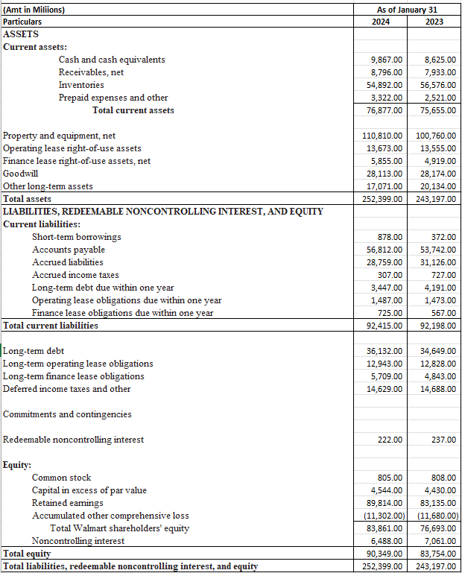
Balance Sheet
Walmart's total assets increased by 3.78% from 2023 to $2,52,399 million in 2024 indicating that Walmart has expanded its operations.
Current Assets increased by 1.6%, led by a strong rise in cash (+14.4%) and receivables (+10.9%), signaling improved liquidity and credit management.
Property and Equipment grew by 10.0%, reflecting Walmart's investments in store upgrades, automation, and supply chain improvements.
Goodwill decreasing means no major acquisitions or impairments.
Short-term borrowings rose sharply by 136% in 2024, indicating increased short-term financing.
Walmart is making good returns for its stockholders, as the total shareholders equity grew by 7.87% from $76,693 million in 2023 to $83,861million in 2024.

Slide 11
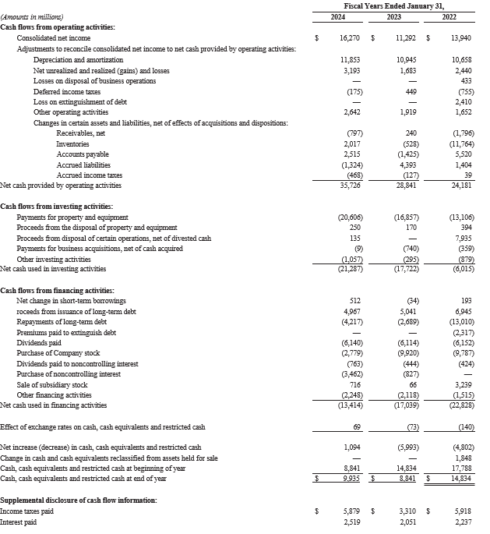
STATEMENT OF CASH FLOWS
Cash Flow from Operating Activities
Walmart's net income increased 44.3% in 2024 compared to 2023, indicating increasing profitability.
Walmart's increasing operational efficiency and ability to generate cash from its core business operations are demonstrated by the 24% rise in cash generated from operating activities.
Cash Flow from Financing Activities
Walmart reduced its cash outflow from financing activities by 21% in 2024, primarily because of reduced stock buybacks and improved debt management.
Walmart paid off $4,217 million in long-term debt in 2024, which was more than the $2,689 million it paid off in 2023. This indicates that Walmart focused more on debt and interest payments.
Cash Flow from Investing Activities
Capital expenditures increased by 22.2%, reflecting Walmart's significant investments in property, equipment, and automation.
Proceeds from property/equipment disposals grew 47.1%, business acquisition payments dropped 98.8%, but overall cash used in investing activities increased 20.1%.

Slide 12
Ratio Analysis
Liquidity Ratios
Solvency Ratios
Profitability Ratios
Activity Ratios
2024
Cash Ratio - 0.11
Quick Ratio - 0.24
Current Ratio - 0.83
2024
Debt to Equity ratio - 1.63
Debt to asset ratio - 0.58
Interest Coverage Ratio - 13.64
2024
Gross Profit Ratio - 23.73%
Return on Assets - 6.26%
Net Profit Ratio – 2.39%
2024
Asset Turnover Ratio – 2.62
Inventory Turnover Ratio – 8.79
Days Inventory Outstanding – 41.52 days
2023
Cash Ratio - 0.094
Quick Ratio - 0.21
Current Ratio - 0.82
2023
Debt to Equity ratio - 1.61
Debt to asset ratio - 0.55
Interest Coverage Ratio – 11.50
2023
Gross Profit Ratio - 23.46%
Return on Assets – 4.89%
Net Profit Ratio – 1.91%
2023
Asset Turnover Ratio – 2.56
Inventory Turnover Ratio – 8.30
Days Inventory Outstanding – 43.98 days

Slide 13
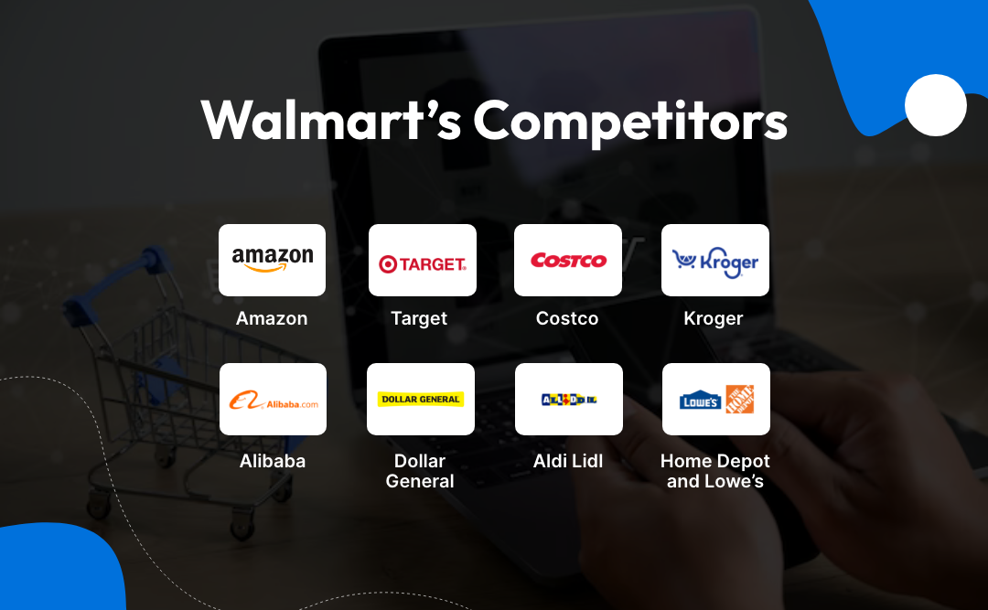

Slide 14
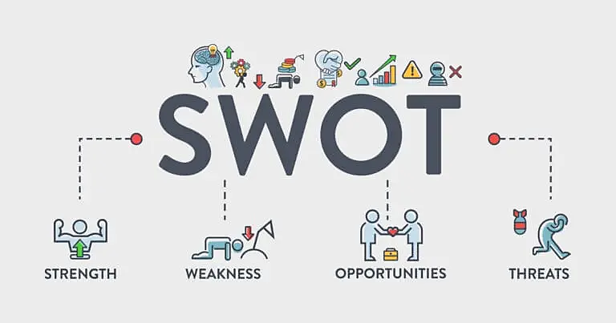

Slide 15

STRENGHTS
Good Reputation: One of the largest retailers in the world, Walmart has a strong reputation as a brand. It has significant advantages over competitors, including economies of scale.
Massive scale and worldwide reach, with more than 10,500 outlets spread over 24 nations.
Robust Financial Performance: Robust cash flows and steady revenue growth (FY 2024: $648 billion) show sound financial standing.
Cost Leadership: Walmart's economies of scale allows it to offer low prices, maintaining a competitive edge.
E-commerce Growth: Walmart's digital transformation, which includes partnerships and online sales, enhances its omnichannel reputation.
Effective Supply Chain: Modern logistics, automation, and technological expenditures guarantee effective operations.

Slide 16
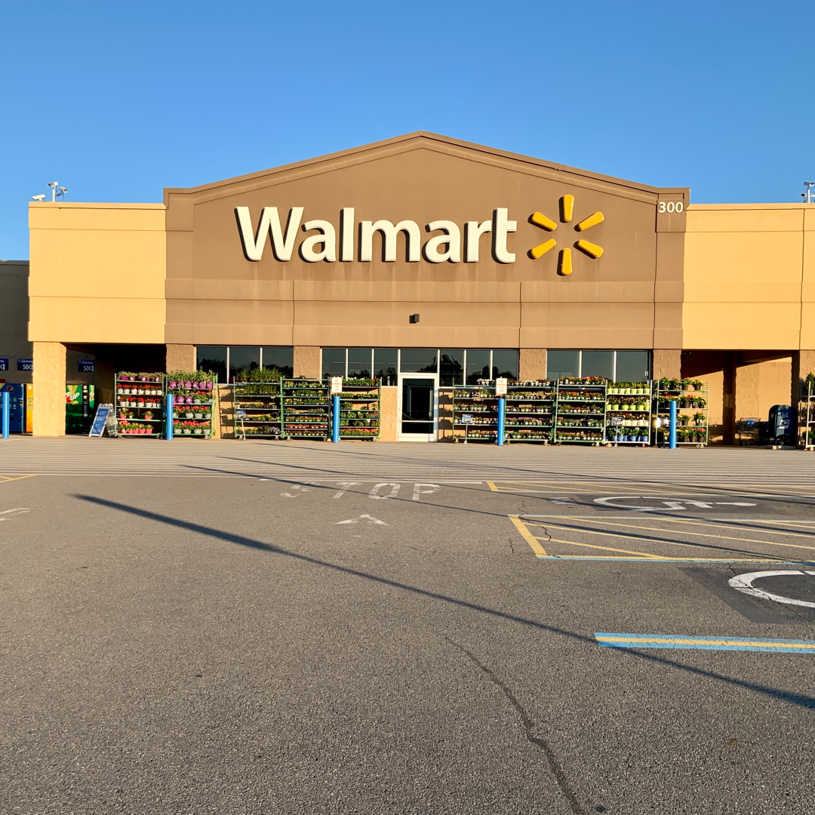
WEAKNESSES
Low pay, inadequate benefits, and a lack of safety regulations are labor difficulties. High employee turnover results from this.
E-commerce businesses are falling behind competitors such as Amazon in areas like product selection, shipping time, and customer experience.
Excessive reliance on the US market to generate the majority of income.
Slow International Growth: Challenges in foreign markets (e.g., exits from Germany and South Korea) limit its global expansion.

Slide 17

OPPORTUNITIES
Technology and E-Commerce: Walmart can compete with Amazon by growing its digital platforms, AI, and e-commerce.
Sustainability Initiatives: In line with worldwide trends, Walmart is concentrating on trash reduction, EV charging stations, and renewable energy.
Growth in Emerging Markets: There are a lot of growth prospects by entering Asia, Africa, and Latin America.
Innovative Delivery Options: Investing in intelligent supply chains and drone delivery can improve the client experience.
Private Label Brands: Increasing investment in private label products can improve margins and customer loyalty.

Slide 18
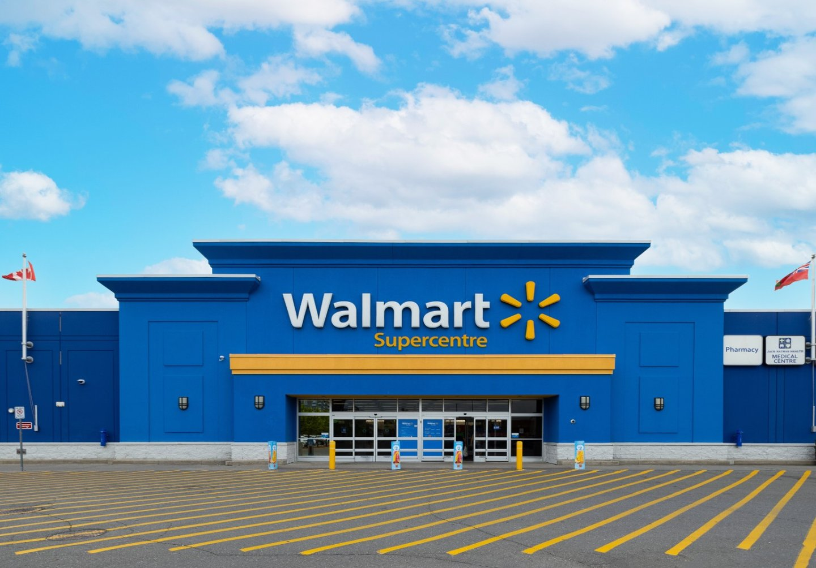
THREATS
Intense Competition: Walmart faces strong competition from Amazon, Costco, and Target, particularly in e-commerce.
Economic Uncertainty: Recession risks, inflation, and rising costs can reduce consumer spending.
Changing Consumer Behavior: Preference for online shopping and ethical brands may shift demand away from Walmart’s traditional model.
Technological Disruptions: Rapid changes in technology may require constant innovation to maintain market leadership.
Regulatory Challenges: Labor laws, antitrust scrutiny, and environmental regulations pose compliance risks.

Slide 19

Conclusion
Walmart’s strong market leadership, driven by strategic investments in technology, sustainability, and global expansion, positions it as a resilient player in the retail industry. Its focus on enhancing customer experiences through Walmart+, innovative delivery solutions, and omnichannel strategies ensures it remains competitive in the evolving retail landscape. With continuous improvements in staff development, operational efficiency, and sustainable practices, Walmart is well-prepared to tackle challenges and seize growth opportunities. The company’s ability to adapt to modern consumer preferences and market demands underscores a future that is not only promising but also sustainable.

Slide 20

THANK YOU!
- Prepared by Niket Shah

